Slide 1
Lexington Ave & Missouri Ave
Public Works
March 14, 2024

Slide 2
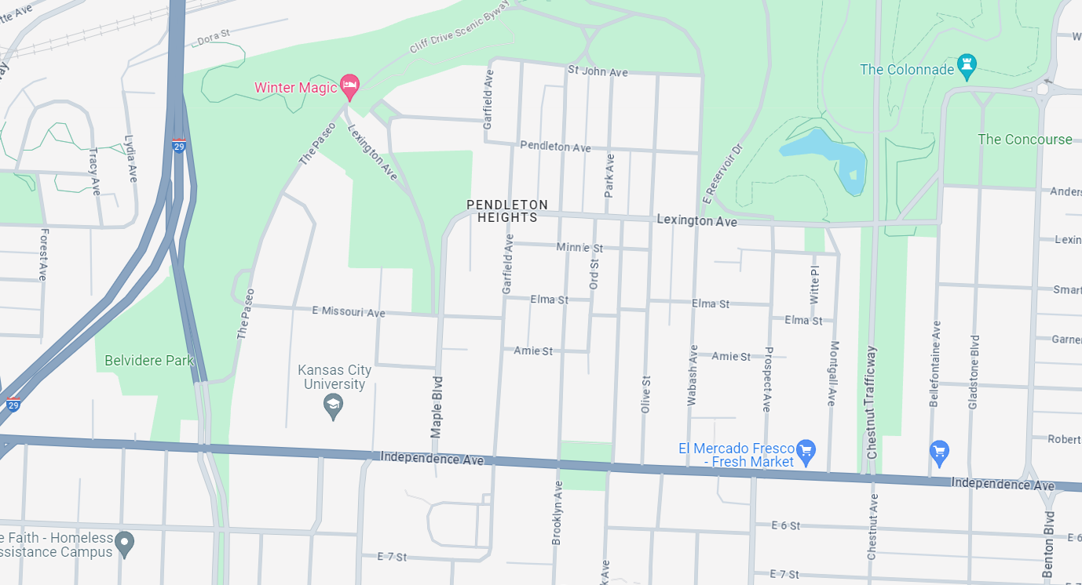
Lexington Ave Project Background
Public Works
Lexington Ave
Missouri Ave
Legend
Sharrows and traffic calming – proposed
Cycle track - existing
Independence Ave

Slide 3
Traffic Calming Elements
Public Works

Slide 4
Traffic Calming Elements
Public Works

Slide 5
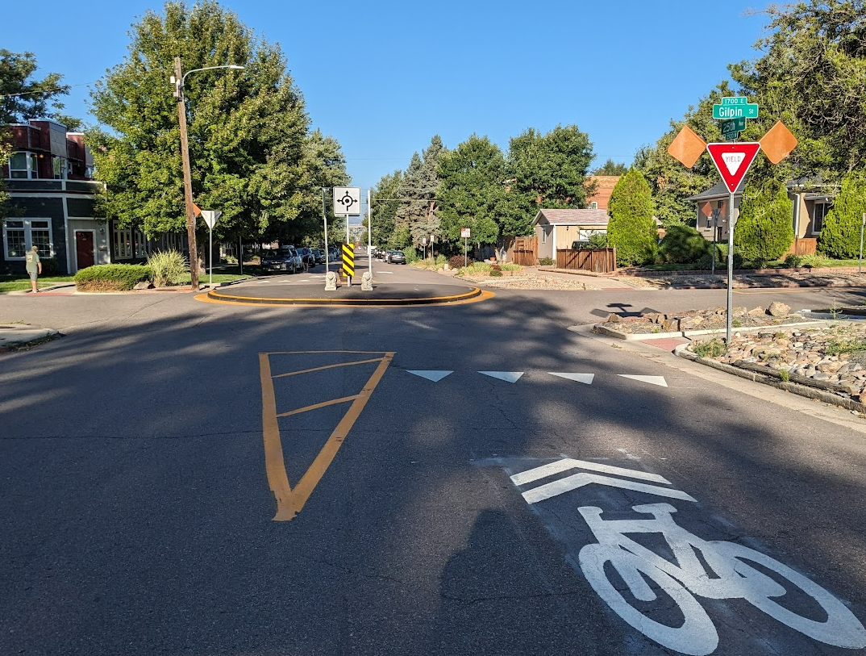
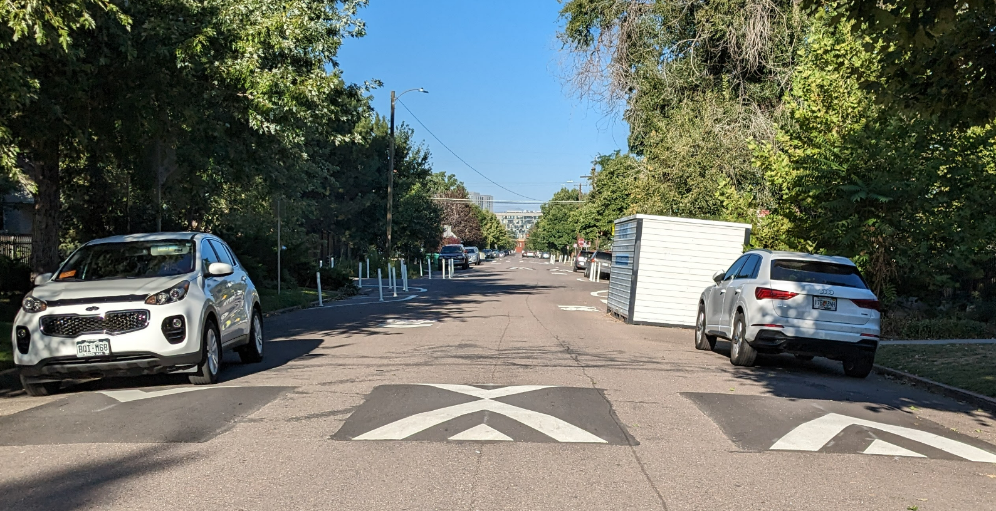
Proposed Design – Slow Shared Street
Public Works

Slide 6
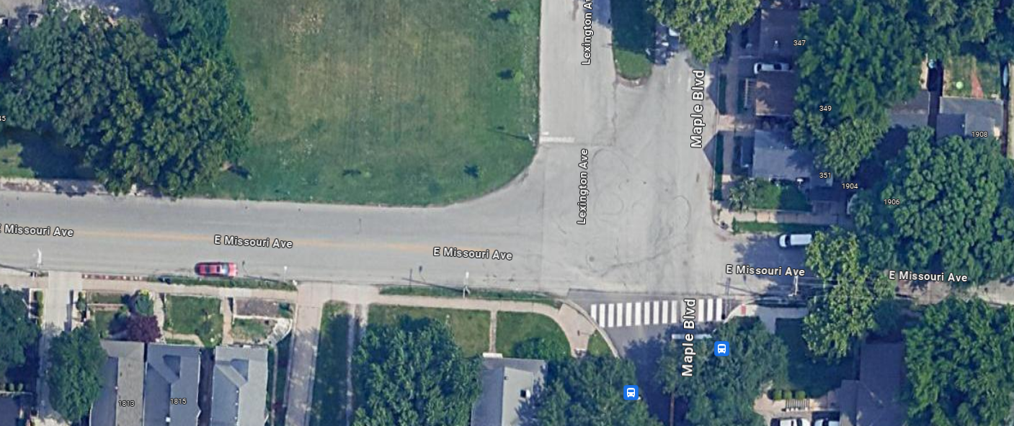
Public Works
Roundabout – Maple & Missouri Ave

Slide 7
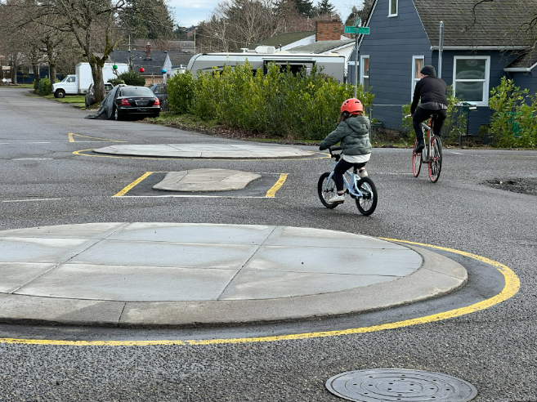
Public Works
Roundabout
Style

Slide 8
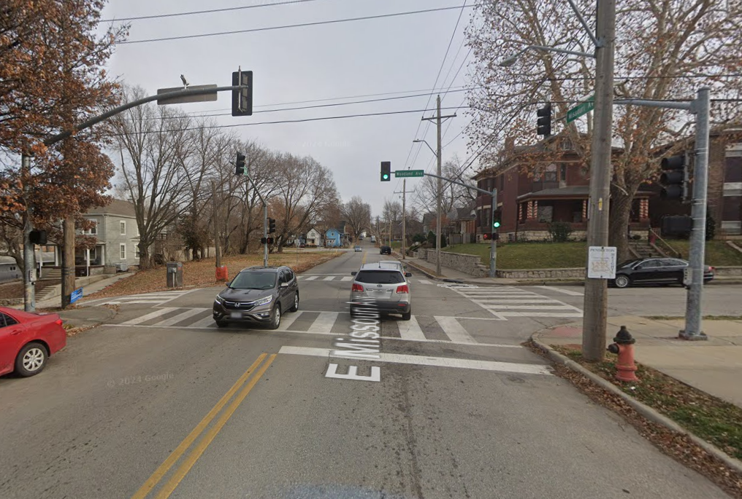
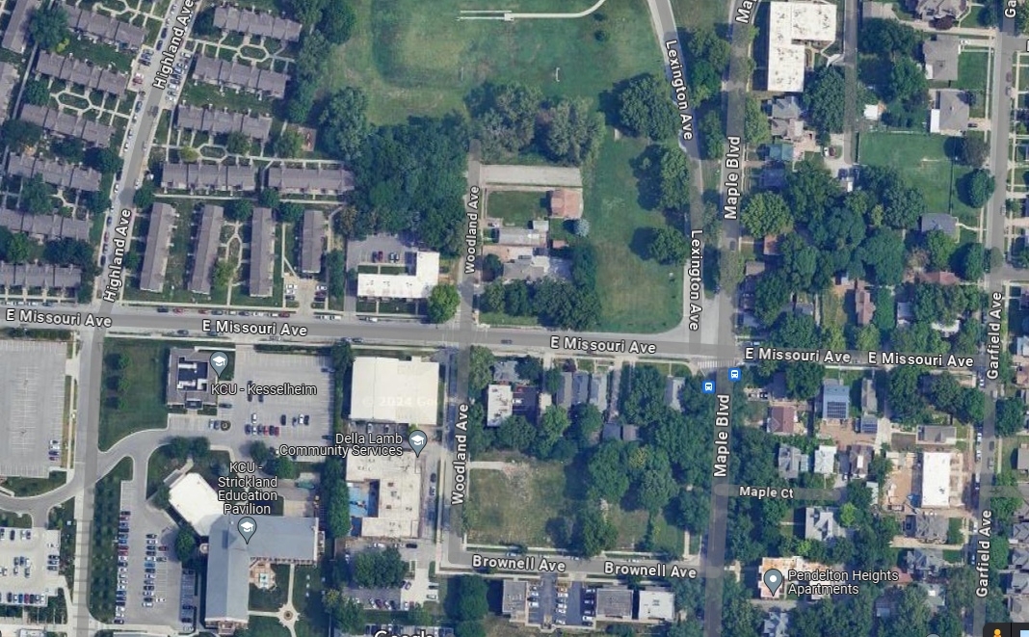
Intersection - Missouri & Woodland
Public Works

Slide 9
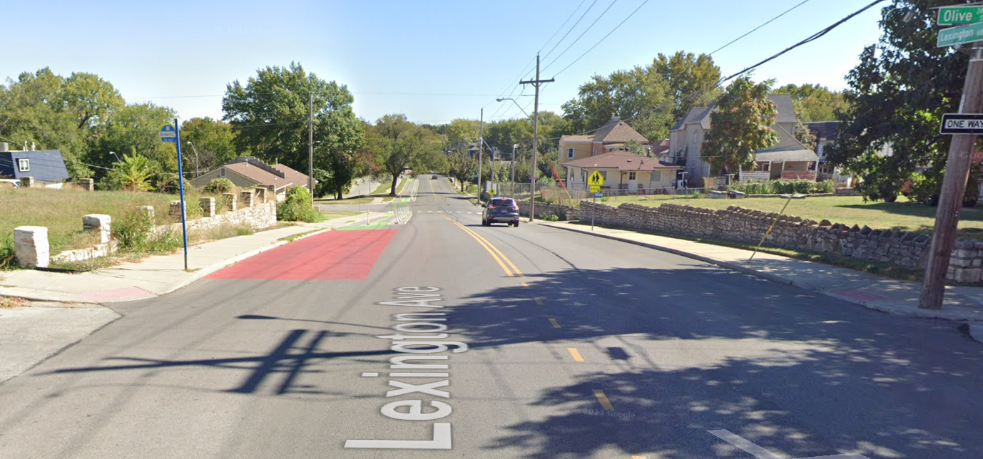
Intersection – Lexington & Olive
Public Works
Transition for bicyclists into existing cycle track

Slide 10
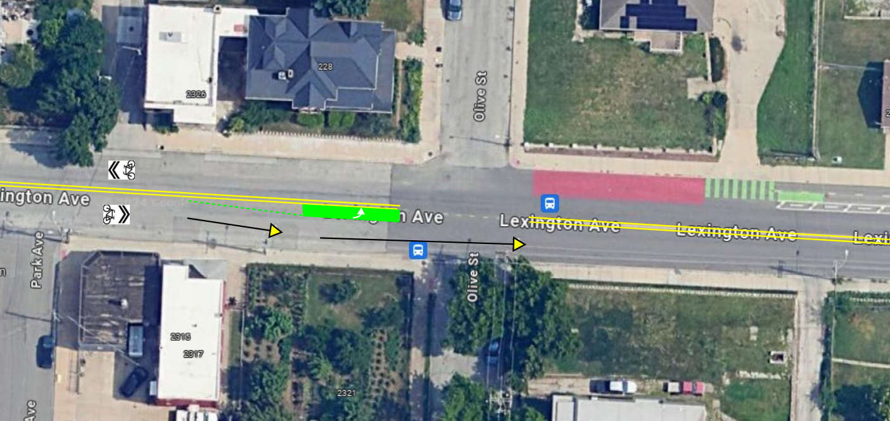
Transition Design
Public Works

Slide 11
Project Contact Information
Public Works
Bailey Waters
Bailey.waters@kcmo.org
816-513-2791

Slide 12
Public Works

